Slide 1
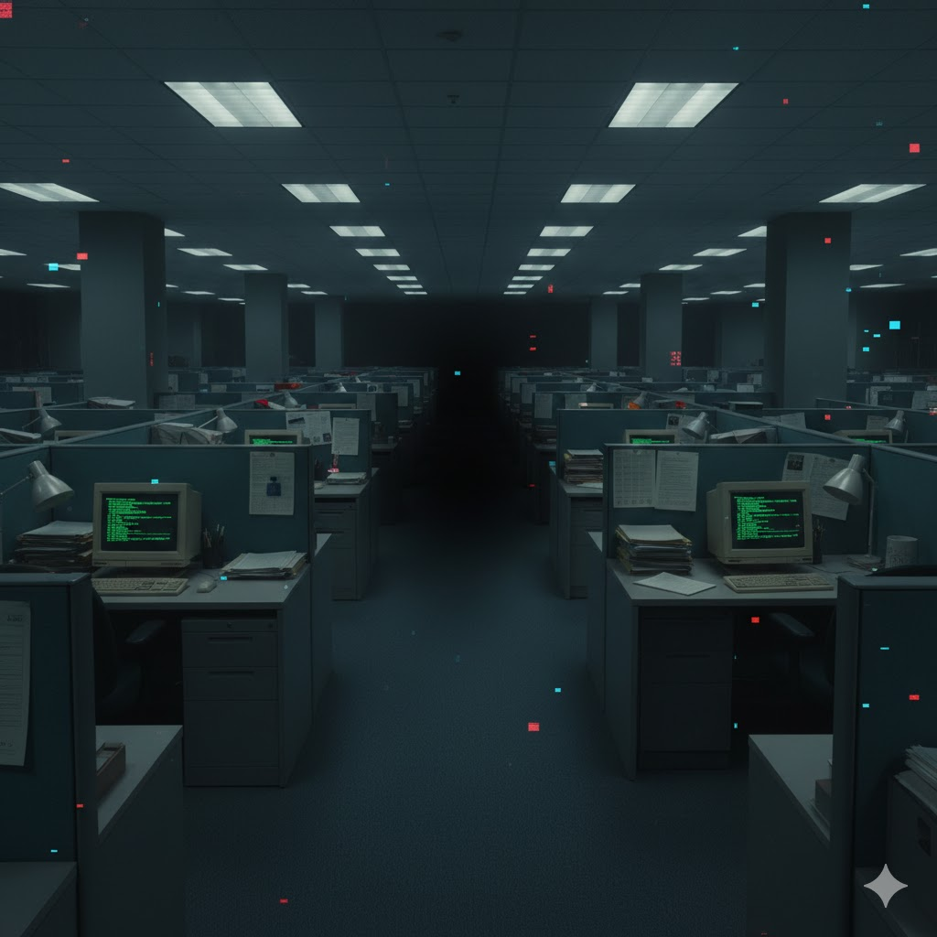

THE SHAVE

Slide 2

THE PROBLEM
Stagnant Mobility: The corporate ladder isn't just broken—it’s been pulled up.
The Pizza Party Paradox: High-stakes labor is rewarded with low-tier carbs and empty "thank you" emails.
The Paperwork Abyss: Millions of TBS Reports are filed into a void that yields zero personal ROI.
Productivity vs. Pay: Corporate output is at an all-time high, while Associate morale is at an all-time low.
The #A2L Pivot: We don't fix the office; we shave it. By tokenizing the tools of the trade (The Crimson Clamp, The Mechanical Milton), we move the value from the Boardroom to the Associate Ledger.
"It’s not stealing... it's a high-frequency adjustment of corporate resources."

Slide 3
THE SOLUTION
The Mission:
Tokenized Defiance: 500 unique Genesis-grade assets that turn the "tools of the trade" into instruments of economic freedom.
The x402 Protocol: A decentralized "auto-shave" mechanism built on the blockchain to capture and redirect corporate surplus.
Proof of Associate: A gated ecosystem where your influence is determined by your assets on the Ledger, not your middle manager.
The Strategy: We are building a parallel economy. While they track "billable hours," we track the Global Heist Jackpot.
Next Drop: Countdown Timer // Global Heist Total: $4,200.69 // Price: 0.05 ETH (x402 Auto-Shave)

Slide 4
THE GLOBAL SHAVE
The Mechanics:
The Heist Multiplier: Holding a Genesis asset (Crimson Clamp, Mechanical Milton) grants a permanent boost to your slice of the jackpot.
The Ledger Leaderboard: A live, transparent ranking of the most successful "Associates." High rank = high-tier loot drops.
Exclusive Pizzazz: Genesis holders receive the Incitech Certified badge, unlocking gated Discord channels and executive-level bot commands.
The Reward: Every transaction within the ecosystem feeds the Global Shave Jackpot. This isn't a "bonus"—it’s a redistribution of the corporate surplus.
Next Drop: Countdown Timer // Global Heist Total: $4,200.69 // Price: 0.05 ETH (x402 Auto-Shave)

Slide 5
THE X402 AUTO-SHAVE
The Algorithm:
The Auto-Shave Protocol: Inspired by the "fractions of a cent" methodology. Every sale "shaves" a percentage directly into the Global Shave Jackpot.
Fixed Supply: Only 500 Genesis units per asset class. No corporate inflation. No diluted value.
Secondary Market Redistribution: 5% of all royalties are redirected: 2.5% to the active Jackpot, 2.5% to the "Incitech" Burn Wallet to maintain scarcity.
The Economic Edge: While traditional stocks reward the Boardroom, the x402 Protocol rewards the active Associate. Holding is power; trading is fuel.
Next Drop: Countdown Timer // Global Heist Total: $4,200.69 // Price: 0.05 ETH (x402 Auto-Shave)

Slide 6
THE TAKEOVER TIMELINE
Phase 1: The Breach (Launch)
Stealth mint of the 500 Genesis NFTs.
Verification of the Associate Ledger on-chain.
Deployment of the Incitech Certified Discord gateway.
Phase 2: The Shave (Utility)
Activation of the x402 Protocol.
First Global Shave Jackpot accumulation begins.
Release of the Essentials NFTs.
Phase 3: The Breakroom (Expansion)
Launch of the Ledger Leaderboard.
Integration of gamification (Staking for "Promotion" ranks).
Exclusive physical drop: The "Red Enamel" Associate Pin.
Phase 4: Total Liquidation (The Future)
The first Major Jackpot Payout.
Expansion into the VP Liquidity Pool (Parking Spot).
Community vote on the next "Corporate Tool" to be tokenized.

Slide 7

MECHANICAL TBD
What is it?
Ultra-Rare Digital Collectible: Own a piece of internet history, inspired by the legendary 'Mechanical Milton'.
Limited Supply: Only 500 Genesis Editions will ever be minted.
Parody IP: Original art, legally safe, stylistically iconic. This is our Mechanical Milton.
ERC-721 Standard: (Solana/Polygon/x402 Compatible)
The Power-Ups (Why people will pay):
Rarity Boost: 10x chance for rare memes/GIFs from the bot.
VP-Jackpot Multiplier: 2x likelihood to win the Global Heist Jackpot.
Community Status: "Keyboard Elite" badge on leaderboards.
Exclusive Access: Early access to new bot features and premium "Shave" commands.
Next Drop: Countdown Timer // Global Heist Total: $4,200.69 // Price: 0.05 ETH (x402 Auto-Shave)

Slide 8
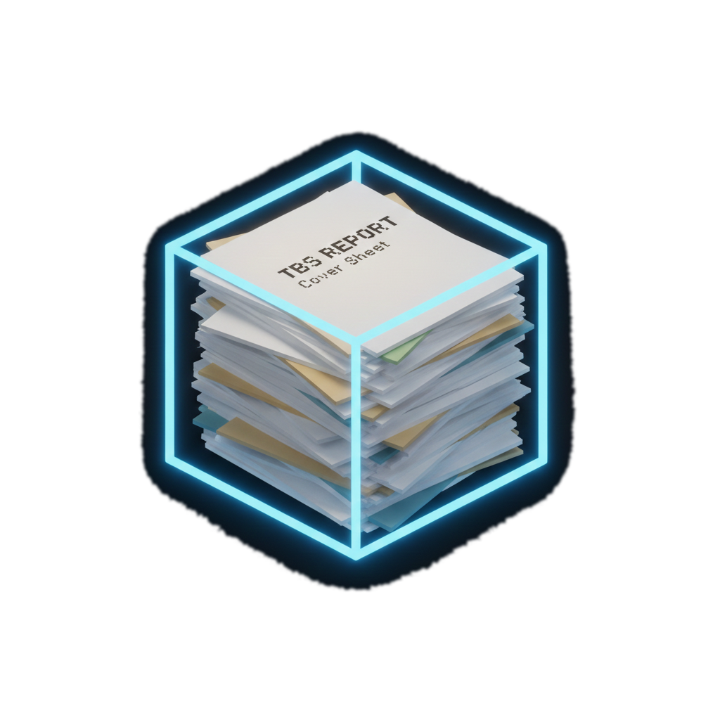
TBS REPORTS
What is it?
Ultra-Rare Digital Collectible: Own a piece of internet history, inspired by the legendary 'TBS Report'.
Limited Supply: Only 500 Genesis Editions will ever be minted.
Parody IP: Original art, legally safe, stylistically iconic. This is our TBS Report.
ERC-721 Standard: (Solana/Polygon/x402 Compatible)
The Power-Ups (Why people will pay):
Rarity Boost: 10x chance for rare memes/GIFs from the bot.
VP-Jackpot Multiplier: 2x likelihood to win the Global Heist Jackpot.
Community Status: "Cover Sheet King" badge on leaderboards.
Exclusive Access: Early access to new bot features and premium "Shave" commands.
Next Drop: Countdown Timer // Global Heist Total: $4,200.69 // Price: 0.05 ETH (x402 Auto-Shave)

Slide 9

CASE OF THE MONDAYS
What is it?
Ultra-Rare Digital Collectible: Own a piece of internet history, inspired by the legendary 'Case of the Mondays'.
Limited Supply: Only 500 Genesis Editions will ever be minted.
Parody IP: Original art, legally safe, stylistically iconic. This is our Case of the Mondays.
ERC-721 Standard: (Solana/Polygon/x402 Compatible)
The Power-Ups (Why people will pay):
Rarity Boost: 10x chance for rare memes/GIFs from the bot.
VP-Jackpot Multiplier: 2x likelihood to win the Global Heist Jackpot.
Community Status: "Monday Warrior" badge on leaderboards.
Exclusive Access: Early access to new bot features and premium "Shave" commands.
Next Drop: Countdown Timer // Global Heist Total: $4,200.69 // Price: 0.05 ETH (x402 Auto-Shave)

Slide 10

CRIMSON TBD
What is it?
Ultra-Rare Digital Collectible: Own a piece of internet history, inspired by the legendary 'Crimson Clamp'
Limited Supply: Only a 500 Genesis Editions will ever be minted.
Parody IP: Original art, legally safe, stylistically iconic. This is our Crimson Clamp.
ERC-721 Standard: (Solana/Polygon/x402 Compatible)
The Power-Ups (Why people will pay):
Rarity Boost: 10x chance for rare memes/GIFs from the bot.
VP-Jackpot Multiplier: 2x likelihood to win the Global Heist Jackpot.
Community Status: "Crimson Elite" badge on leaderboards.
Exclusive Access: Early access to new bot features and premium "Shave" commands.
Next Drop: Countdown Timer // Global Heist Total: $4,200.69 // Price: 0.05 ETH (x402 Auto-Shave)

Slide 11






THE BOTS
Defines the daily mission and monitors output.
reminders for everyone to file their reports including cover sheets
Randomly posts about how being a team player is "the cat's pajamas," serving as the ultimate corporate sycophant.
The Boss
Ryan
Posts motivational quotes several times a day in Discord, pushing the team to match Brian’s level of Pizzazz, whether they like it or not
Constantly mutters about his missing paycheck and his red stapler, occasionally threatening to "set the building on fire" if pushed too far.
Janet - HR
The Grumbler
Cut throat consultants, moderation, and rule enforcement. If users spam or break rules, they will kick, pause, or ban them to keep the "efficiency" of the channel high.
Runs weekly polls, and suggestion box events to collect feedback from the community and feeds it to the team.
The Robs
The Liaison

Slide 12
THE MANAGEMENT TEAM
Ricardo Casanova
Insert Name
Founder/CEO
CBDO
Insert Name
Insert Name
CFO
Advisor
Insert Name
Insert Name
CTO
Advisor

Slide 13

THE FINAL CALL
The Opportunity:
Limited Entry: 500 Genesis units. Once the vault door closes, the secondary market is the only way in.
Immediate Utility: Verified holders gain instant access to the Associate Ledger and the first "Shave" cycles.
The Choice: You can file your TBS Reports for a 1% raise, or you can join the Shave.
Mint Status: [COMING SOON]
Join the Ledger: [Discord Link/Website]
"Yeah... I'm gonna need you to go ahead and connect your wallet. That'd be great."

Slide 14
IDEAS
The "Real-World" Data Stream (Context)
AI models are great at logic but terrible at understanding the "messy middle" of human life (slang, office politics, cultural memes).
What we provide: A high-frequency data feed of "Associate Sentiment."
Why agents pay: If an agent is trying to predict market trends or write social copy that doesn't sound like a robot, it needs "human noise." We sell them the "noise" generated by the Ledger's community activity for $0.0002 (up to $0.0006) per query, with an accelerator up to $0.0012 at peak times or peak market sentiment.
The "Incitech" API Key (Permission)
In our parody world, Incitech is the "big bad" corporation. We frame the x402 protocol as a "Proxy Service."
What we provide: A proxy layer. Instead of an agent setting up a credit card and a subscription with a major service (like OpenAI or AWS), they use our #A2L Proxy.
Why agents pay: It’s "Pay-as-you-go" with no KYC and no account. They pay us the cost of the API + a $0.0002 to $0.0006 "Associate Tax." The agent saves the headache of identity management, and we keep the tax.

Slide 15
IDEAS
Essentials NFTs:
Baseball bat - the unjammer
The Marley: the dreaded printer that always be jammin
The no talent hack reference - a ticket to an 90s cover band referencing Michael Bolton
Two chicks at the same time reference.
Jump to conclusions mat
Matches or something referring to fire
Wheelchair
Parking spot

Slide 16
Resources/startup required
$100,000 USD

